Slide 1
Hospital Management System
Salman Irfan

Slide 2
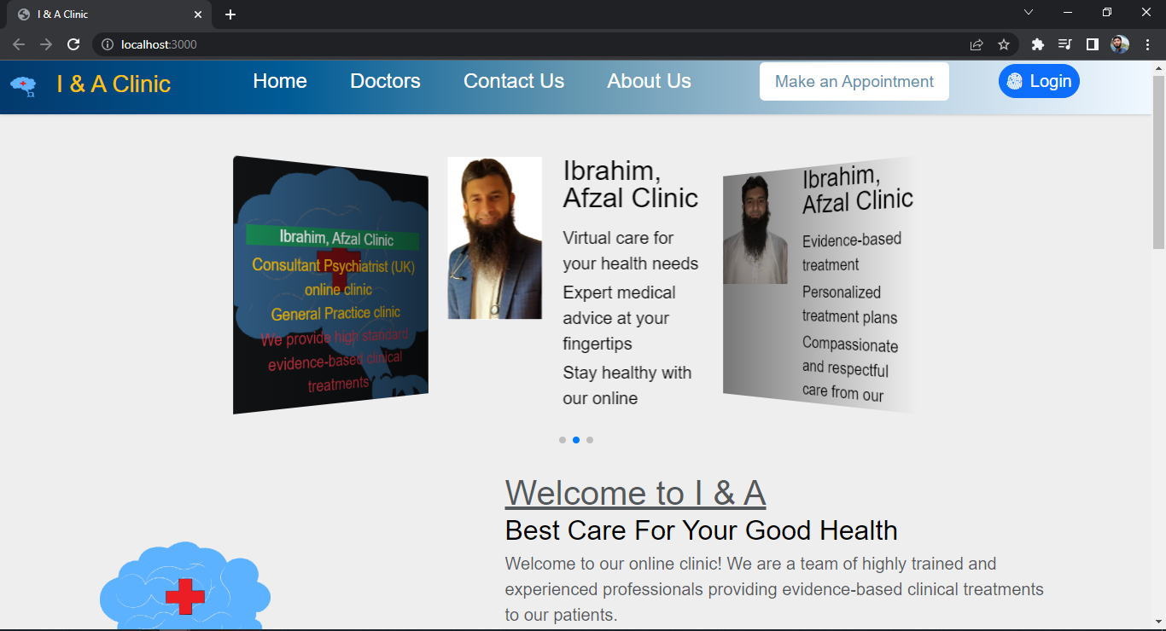
Home Page

Slide 3
React Router Dom
Installed another package for routing between one page to another
#npm I react-router-dom
Routing between I & A Clinic, Home, Doctors, Contact Us, About Us, Make an Appointment, Login

Slide 4
Navbar Component
Bootstrap Navbar Component

Slide 5
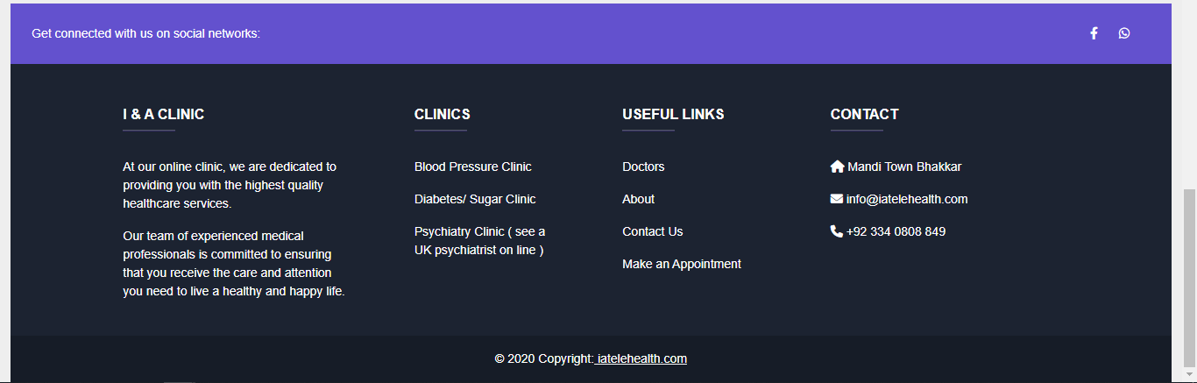
Footer Component
Bootstrap Footer Component

Slide 6

Home Page
Swiper Js, Effect Overflow

Slide 7
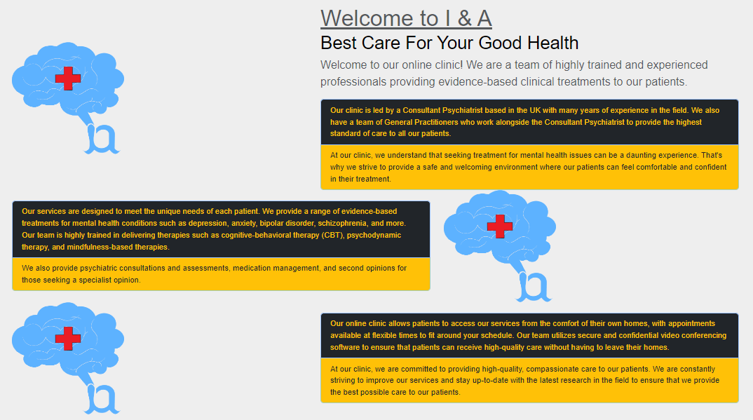
Home Page
Bootstrap element

Slide 8
Home Page
Bootstrap element

Slide 9
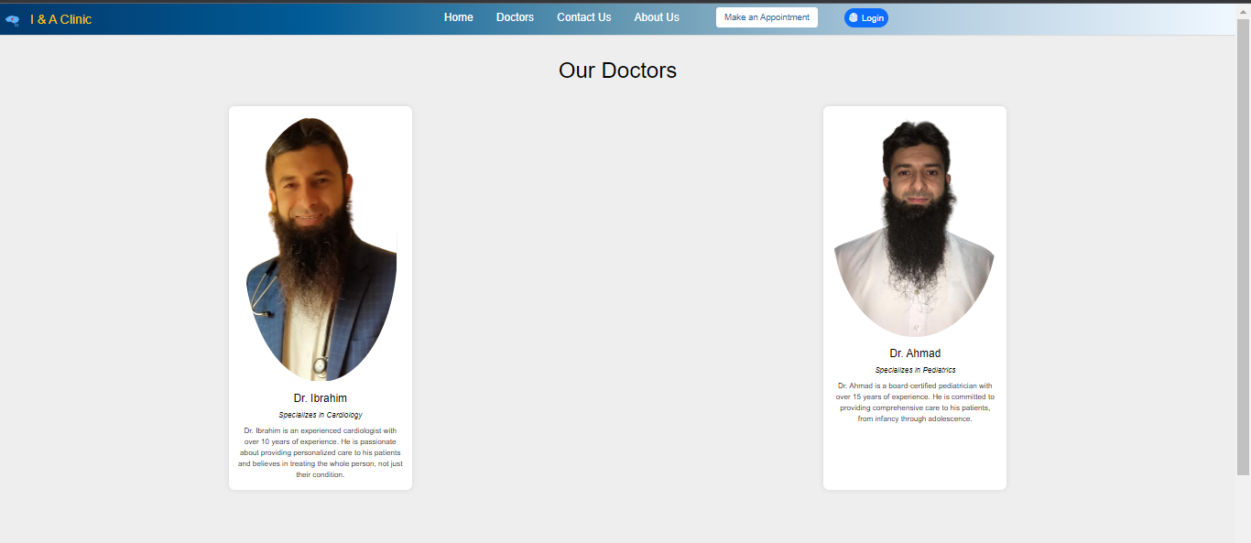
Doctors Page

Slide 10
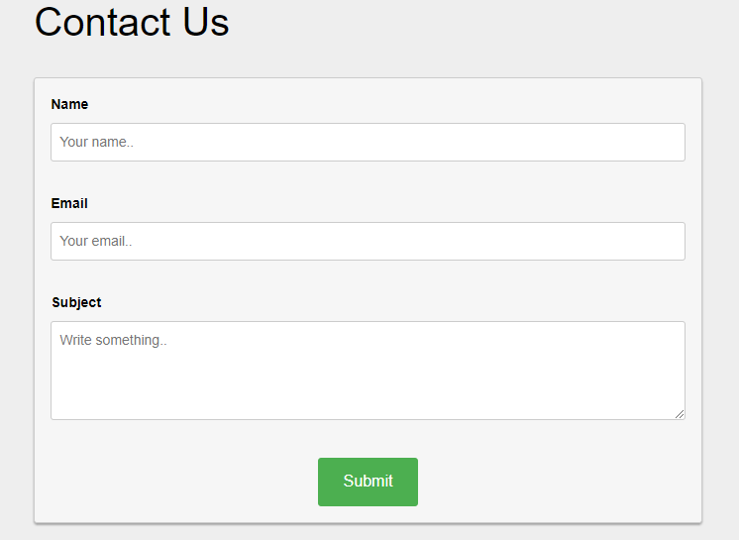
Contact Us Page

Slide 11
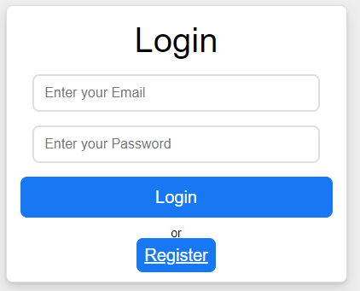
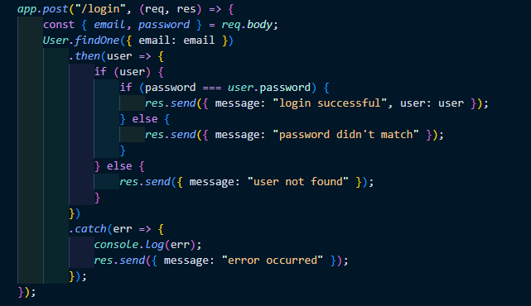
Login Page
Login Code

Slide 12
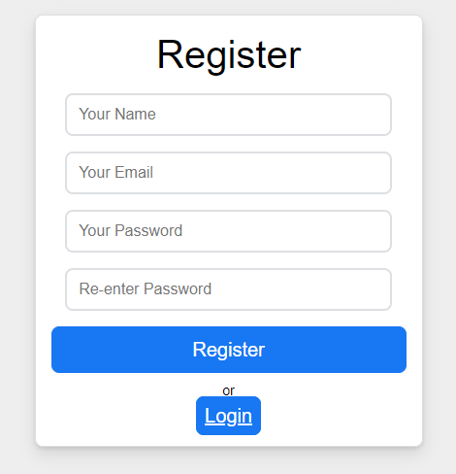
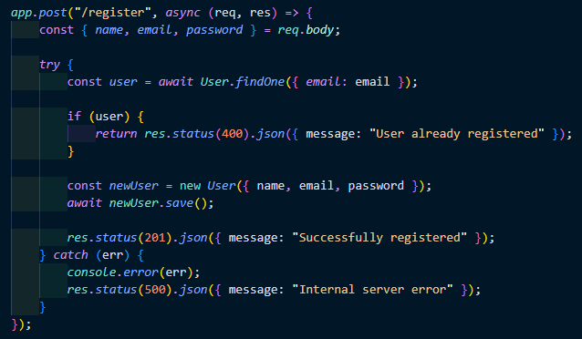
Register Page
Backend Code

Slide 13
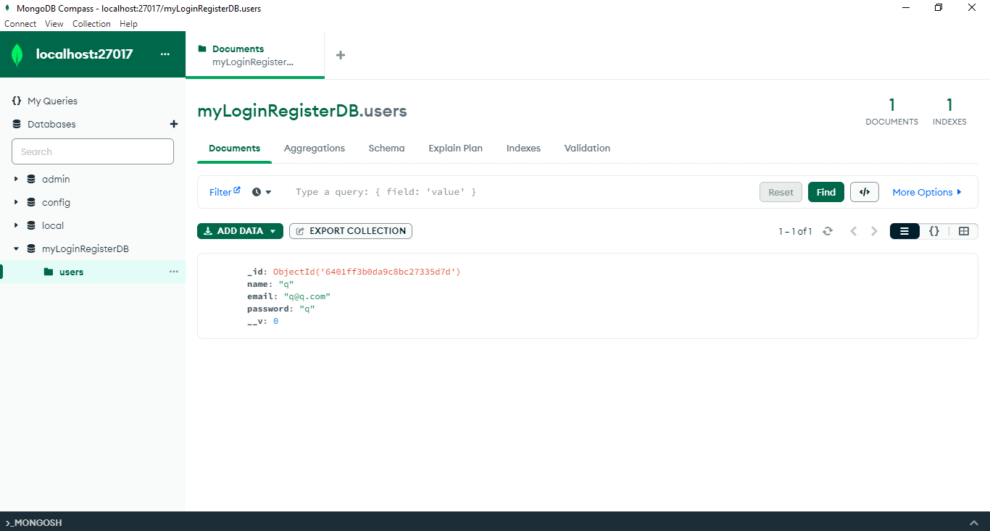
Mongo DB Compass
User Registered in Database

